Slide 1
RAJESWARI VEDACHALAM GOVT.ARTS COLLEGE CHENGALPATTU-603001
DEPT.:BCA
PREDICTING PRESONAL LOAN APPROVAL USING MACHINE LEARNIING
Presenter's name
M.NITHYA
M.MUTHULAKSHMI
M.PARIMALA
V.PAVITHRA
S.SNEHA

Slide 2
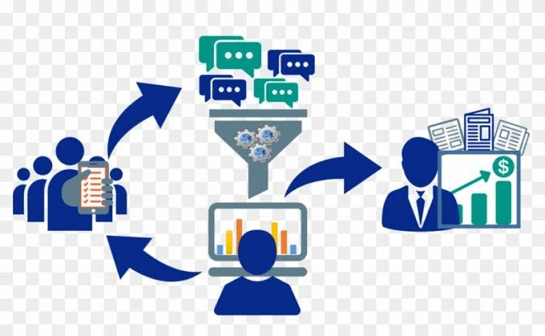
Personal Loan
A personal loan is a loan that does not require collateral or security and is offered with minimal documentation.
You can use the funds from this loan for any legitimate financial need.
A personal loan works pretty much the same way as most loans.

Slide 3
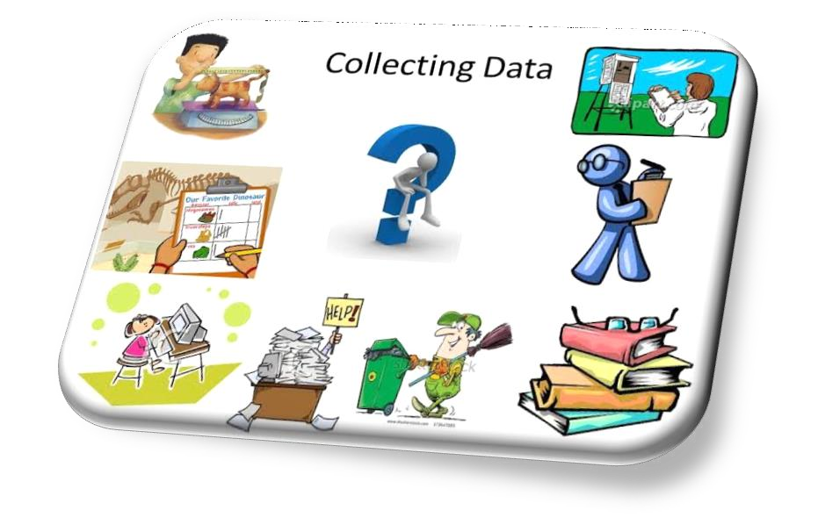
Data Collection and Preparation
Data collection and preparation
Importing the libraries
Read the Dataset
Data Preparation
Handling missing values
Handling Categorical Values
Handling Imbalance Data

Slide 4
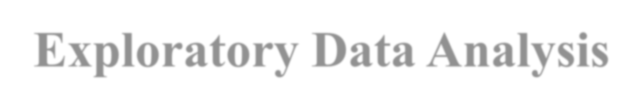
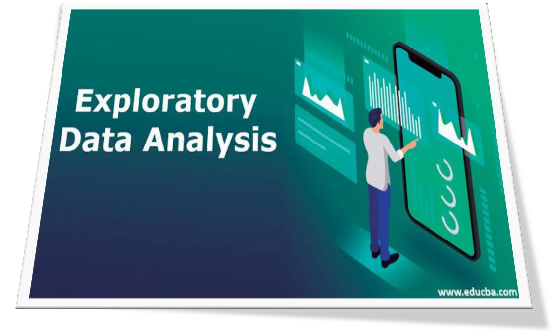
Exploratory Data Analysis
Descriptive statistical
Visual representation of the data distribution Analysis of correlation between two variables.
Identification of outliers and their handling.
UNIVARIATE ANALYSIS
BIVARIATE ANALYSIS
MULTIVARIATE ANALYSIS

Slide 5

Model Selection and Training
Training the model in multiple algorithms
Decision tree model
Random forest model
KNN model
Xgboost model
ANN model
Testing the model
Check the correctness of individual model components.

Slide 6

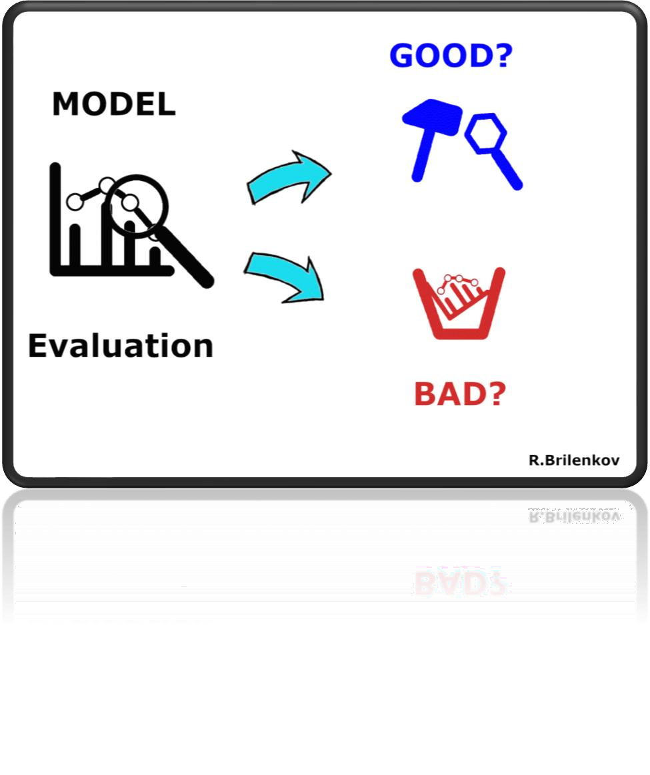
Model Evaluation
Model evaluation is the process of using different evaluation metrics to understand a machine learning model's performance, as well as its strengths and weaknesses.
Explanation of model accuracy and limitations

Slide 7


MODEL DEPLOYMENT
Save the best model
Building Html pages
Build python code
Run the application

Slide 8

FUTURE WORK
Areas for future research and improvement.
Potential ways to improve the model's performance.
Importance of continued development and updating of the model.

Slide 9

Conclusion
Recap of the problem statement and its solution.
Summary of key findings and Conclusions.
Conclusion Machine learning is a powerful tool for making predictions from data.

Slide 10
Thank you

